Slide 1

React Native App with Micro-apps Design Pattern
April 30, 2019

Slide 2
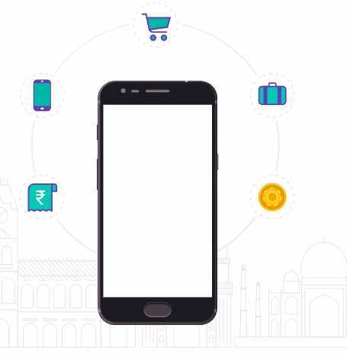
Agenda
Evolution of application architecture
Micro apps what, why and How?
Payment Application

Slide 3
Section 1
Evolution of application architecture

Slide 4
Monolith Application
Frontend
Monolith
Backend
Database

Slide 5
Client Server application
Frontend
Frontend Team
Backend
Backend & Devops
Database

Slide 6
… Monolith
Limitations:
Ship either all or none
Long test/build/release cycle
Target scalability
Team scaling
Technology lock

Slide 7
Micro services
Frontend
Frontend Team
Backend
Aggregation Layer
Database
Micro Services
Micro Services
Micro Services
Micro Services

Slide 8
Microservices Application
Many smaller, clearly scoped services
Multiple application
Single Responsibility Principle - Separate team for separate functionality with no inter-dependency
Independently Managed
Highly testable and maintainable
Each repo can be shipped differently
Independent technology stack

Slide 9
… Micro services
Frontend
Frontend Team
Backend
Aggregation Layer
Database
Micro Services
Micro Services
Micro Services
Micro Services
Micro Services
Micro Services
Micro Services
Micro Services
Micro Services
Micro Services

Slide 10
Micro-frontends
Composite UI
UI Composition + Microservices
UI Composition + Microservices
Aggregation Layer
UI Composition + Microservices

Slide 11
Section 2
Micro apps what, why and How?

Slide 12
MicroApps
Single task
Cross-platform
function offline
be built and deployed without customized code

Slide 13
Micro-Apps
Microapp
Microapp
Microapp
Native App container
OS

Slide 14
How Can we show
Catalogues
Widgets
Conversational UI

Slide 15
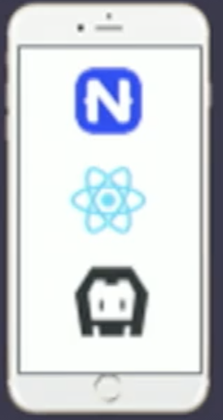
How can we build microapp
Micro app registry
Add as dependencies
Upload on server
Micro services
App
Micro services
Micro services
Micro services
Aggregation layer
Container

Slide 16
Example
Facebook Messenger: Allows users to see who’s online and chat with their friends.
AccuWeather: A world-class weather app to help you track local weather conditions with real-time updates.
IRCTC: Many payment apps are using IRCTC micro app

